Slide 1
STRING METHODS
IN JAVASCRIPT

Slide 2
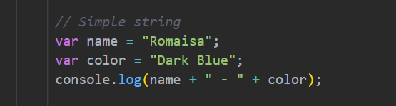
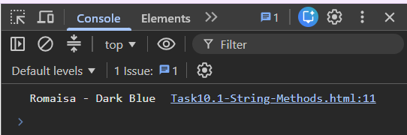
What is a String?
A string is a sequence of characters used to store text in JavaScript. It can contain letters, numbers, symbols, and spaces. Strings are written inside single quotes (' '), double quotes (" "), or backticks ( ).
Why do we use Strings?
Strings are used to store and display textual information such as names, addresses, messages, emails, passwords, and other text-based data.

Slide 3
STRING METHODS
They are built-in JavaScript functions that help us perform different operations on strings. They allow us to search, modify, compare, combine, and extract text without writing long code.
length
toLowerCase()
toUpperCase()
includes()
startsWith()
endsWith()
search()
match()
indexOf()
lastIndexOf()
replace()
trim()
charAt()
concat()
split()
repeat()
slice()
substr()
substring()
toString()
valueOf()
charCodeAt()
String.fromCharCode()

Slide 4
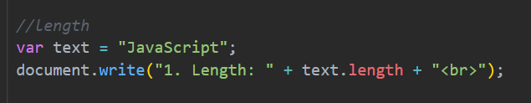

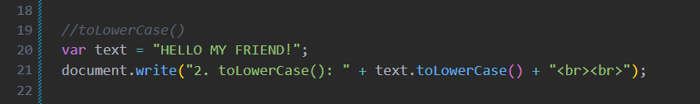
1. length
The length property returns the total number of characters in a string. It counts every character, including letters, numbers, spaces, and special symbols.
2. toLowerCase()
This method converts all uppercase letters in a string into lowercase letters. It returns a new string without changing the original string.

Slide 5

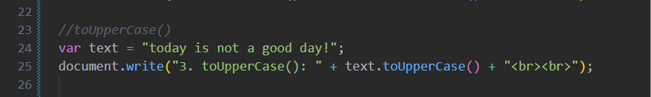
In this, the string “ HELLO MY FRIEND!" is stored in the variable text. The toLowerCase() method converts every uppercase letter into lowercase and displays "hello my friend". The original string remains unchanged.
3. toUpperCase()
This method converts all lowercase letters in a string into uppercase letters. It returns a new string without modifying the original string.

Slide 6
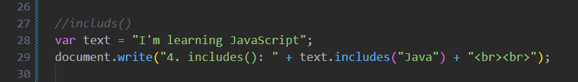

4. includes()
This method checks whether a string contains a specified word or character. If the value exists, it returns true; otherwise, it returns false.
In this, the string “I’m learning JavaScript" contains the word "Java". Therefore, the includes() method returns true, indicating that the specified text exists in the string.
5. startsWith()
This method checks whether a string begins with the specified text. If the string starts with the given value, it returns true; otherwise, it returns false.

Slide 7
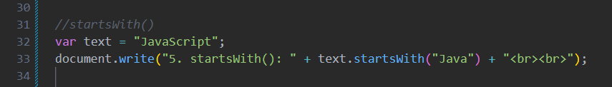

In this example, the string "JavaScript" starts with the word "Java". Therefore, the startsWith() method returns true because the specified text is found at the beginning of the string.
6. endsWith()
This method checks whether a string ends with the specified text. It returns true if the ending matches; otherwise, it returns false.

Slide 8
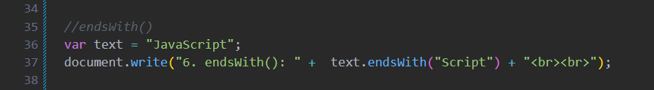

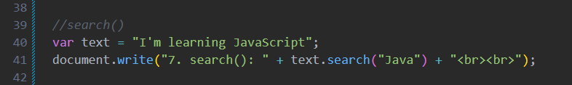
In this, The string "JavaScript" ends with "Script", so the endsWith() method returns true.
7. search()
This method searches a string for a specified value and returns the position of its first occurrence. If the value is not found, it returns -1.

Slide 9

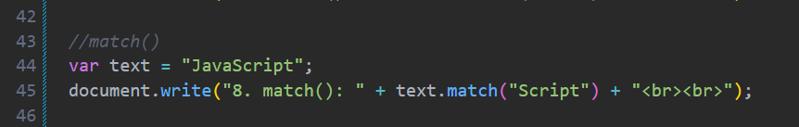

In this, The search() method finds the word "Java" starting at index 7 and returns its position.
8. match()
This method searches a string and returns the matched text. If no match is found, it returns null.

Slide 10
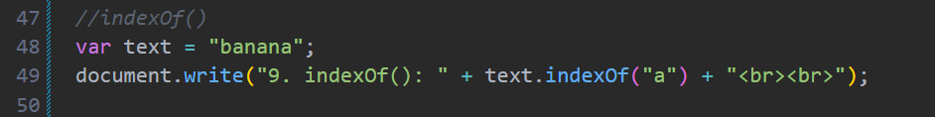

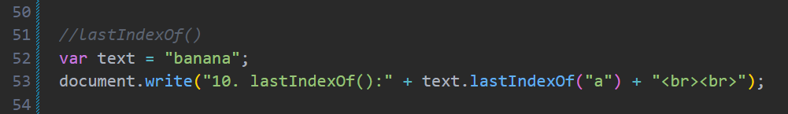
9. indexOf()
This method returns the index (position) of the first occurrence of a specified value in a string. If the value is not found, it returns -1.
10. lastIndexOf()
This method returns the index of the last occurrence of a specified value in a string. If the value is not found, it returns -1.

Slide 11
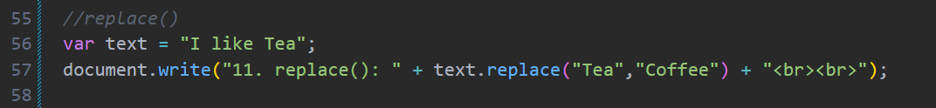

11. replace()
This method replaces the first occurrence of a specified value with another value and returns the updated string.
The replace() method changes the word "Tea" to "Coffee". The updated string is then displayed.
12. trim()
This method removes extra spaces from the beginning and end of a string. It does not remove spaces between words.

Slide 12
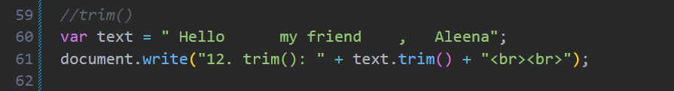

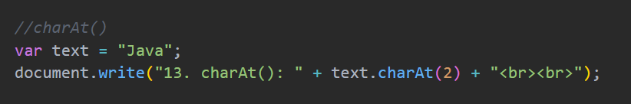

13. charAt()
This method returns the character at a specified index in a string.
The character at index 2 is "v", so charAt() returns "v".

Slide 13
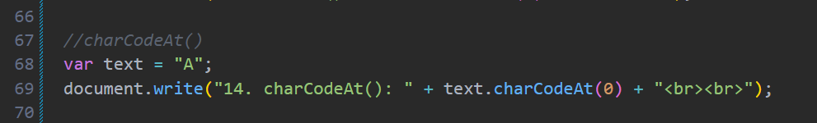

14. charCodeAt()
This method returns the Unicode value of the character at the specified index.
The first character is "A", and its Unicode value is 65, so charCodeAt() returns 65.
15. String.fromCharCode()
This method converts one or more Unicode values into their corresponding characters.

Slide 14
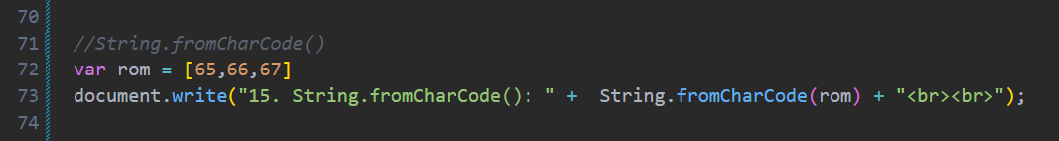

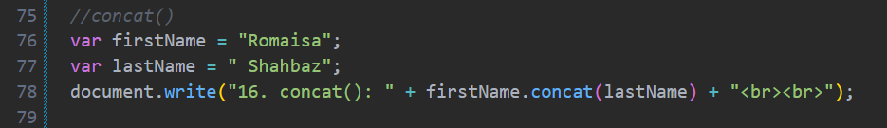
The Unicode values 65, 66, and 67 represent A, B, and C. Therefore, the method returns the string "ABC".
16. concat()
This method combines two or more strings into a single string. It returns a new string without changing the original strings.

Slide 15

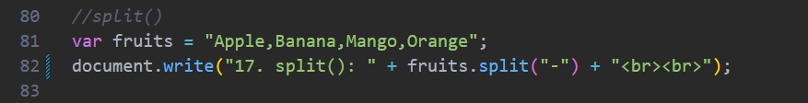

17. split()
This method divides a string into an array using a specified separator. It returns a new array without changing the original string.
The split() method uses the comma (,) as a separator and divides the string into separate values. The result is an array containing Apple, Banana, Mango, and Orange.

Slide 16
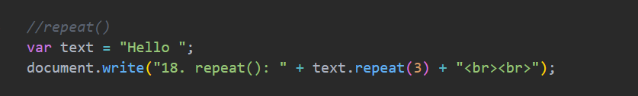

18. repeat()
This method creates a new string by repeating the original string a specified number of times.
In this example, the string "Hello " is repeated 3 times using the repeat() method. The returned string is "Hello Hello Hello".
19. slice()
This method extracts a part of a string and returns it as a new string. It does not change the original string.

Slide 17
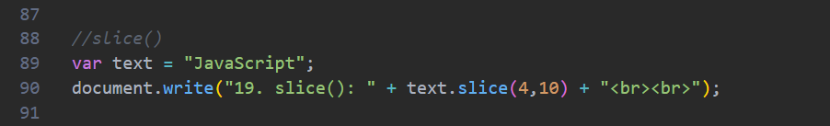

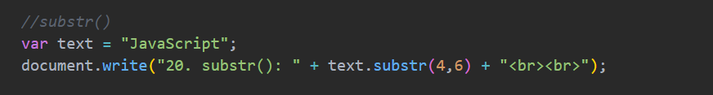
The slice() method starts from index 4 and extracts characters until index 10 (10 is not included). Therefore, it returns "Script".
20. substr()
This method extracts characters from a string starting at a specified position for a given number of characters.

Slide 18

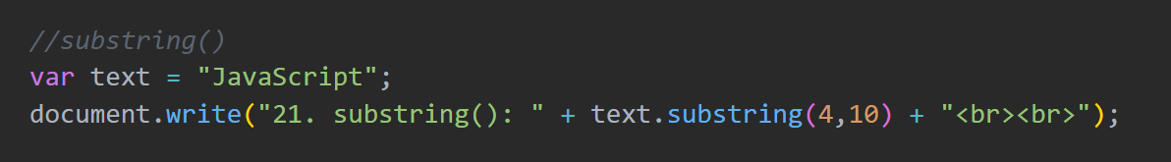

21. substring()
This method returns the characters between two specified indexes. It does not include the ending index.
The substring() method extracts characters from index 4 up to index 10 (excluding 10). The result is "Script".

Slide 19
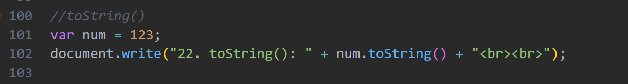

22. toString()
This method converts a value into a string. It is commonly used to convert numbers, arrays, or other data types into string format.
In this example, the variable num stores the number 123. The toString() method converts the number into a string and displays 123.
23. valueOf()
This method returns the original value of a string object. In most cases, it returns the same string stored in the object.

Slide 20
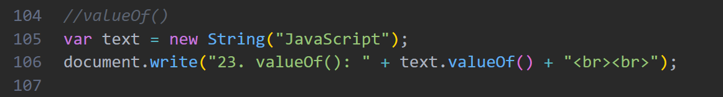

In this example, a String object is created with the value "JavaScript". The valueOf() method returns the original string value stored in the object.
Why do we need String Methods?
String methods are used to easily work with text in JavaScript. They help us search, compare, modify, extract, join, and format strings without writing long code. They save time, reduce code repetition, and make programs easier to understand. String methods are commonly used in login systems, search bars, form validation, text editors, and web applications.

Slide 21
THANK YOU

